Slide 1
Spine Health: The Benefits of a healthy Lifestyle
John M. Lavelle, DO
Functional Spine Physician
Tennessee Orthopaedic Clinics
a division of Tennessee Orthopaedic Alliance

Slide 2
What is HeALth CARE?
Promote Health and Improve Health Span
Reduce biological age despite increasing chronological age
Current medical model is Disease Care
Chases symptoms to prolong life span
Medicine needs to focus on the cause, aka…. THE WHY!
Stop just treating symptoms but find the root cause and cure it!

Slide 3
Learning objectives
Discuss the epidemiology of low back pain
Review the major cause of low back and how it relates to disability
Review exercise and nutrition and its role in the treatment of back pain

Slide 4
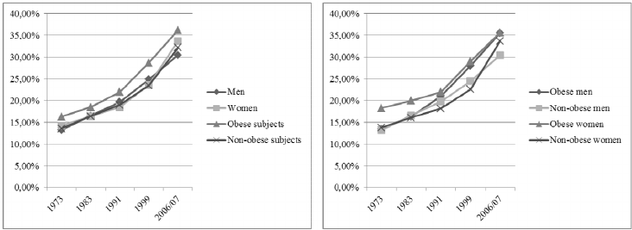
Low Back Pain: Epidemiology
Lifetime prevalence of 80% (Lawrence, Loney)
One year prevalence up to 56%. (Deyo)
24-80% will have recurrence in first year. (Hoy)
Großschädl

Slide 5
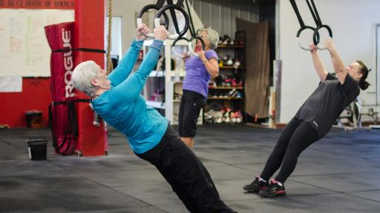
Low Back Pain: Epidemiology
New onset back pain peaks in the 30’s (Atlas).
Yearly prevalence increases with age, peaking in 50’s and 60’s (Hoy).
After age 65 the prevalence
decreases…Golden Years!

Slide 6
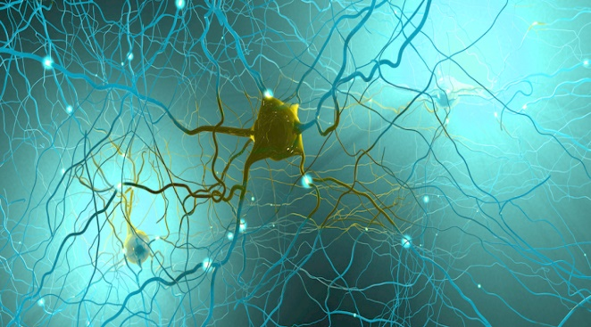
Low Back Pain: Common Myths
Pain is an indicator of damage or injury (Gcoubert)
Actually due to pain hypersensitivity (Butler, Stagg)
Many forms of activity, running, bending, which are not harmful are considered dangerous
Bending, twisting, lifting, running does not induce low back pain (Wai, Lane)
Improvement from low back pain related to the “amazing” clinician who used manipulation, injections, surgery, etc.
most people can control the symptoms themselves through physical activity, stress management, healthy lifestyles (Verbeek).

Slide 7
Low back pain: Anatomy

Slide 8
Low back pain: Imaging
Paraspinal Muscle Atrophy

Slide 9
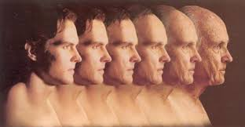
Low back pain: Age –Related Degeneration
Chronological Aging
Everyone develops age related degeneration of the spine…its universal
Like grey hairs and wrinkles

Slide 10
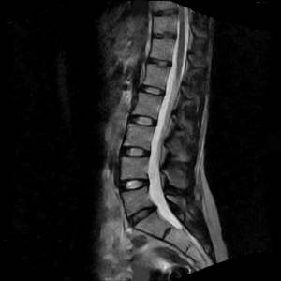
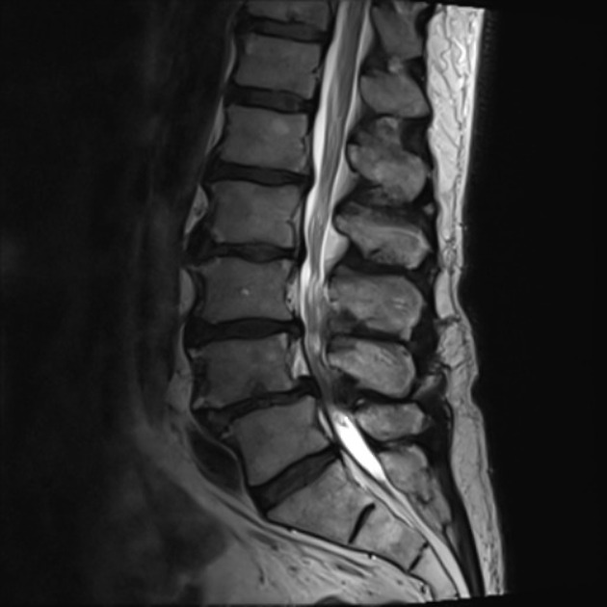
Low Back Pain: Imaging
Spinal degeneration in asymptomatic individuals increased from 37% of 20-year-old individuals to 96% of 80-year-old individuals. (Brinjikji)

Slide 11
Low back pain: Age –Related Degeneration

Slide 12
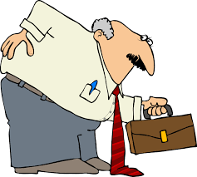
Low back pain: recovery
90% of new onset back pain will resolve in 6 weeks(Carey).
20-44% of people will have recurrences of their back pain (Meidema)
5-20% will become chronic (Shekelle)
20-25% of people never experience
low back pain
- Nervous system adaptation??

Slide 13
Low Back Pain: Disability
Kang, 2015

Slide 14
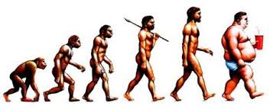
Low back pain: Disability
Risk factors (Hoy):
Low educational status
Stress
Anxiety
Depression
Job dissatisfaction
Low levels of social support in workplace
Smoking
Lack of exercise!!!

Slide 15
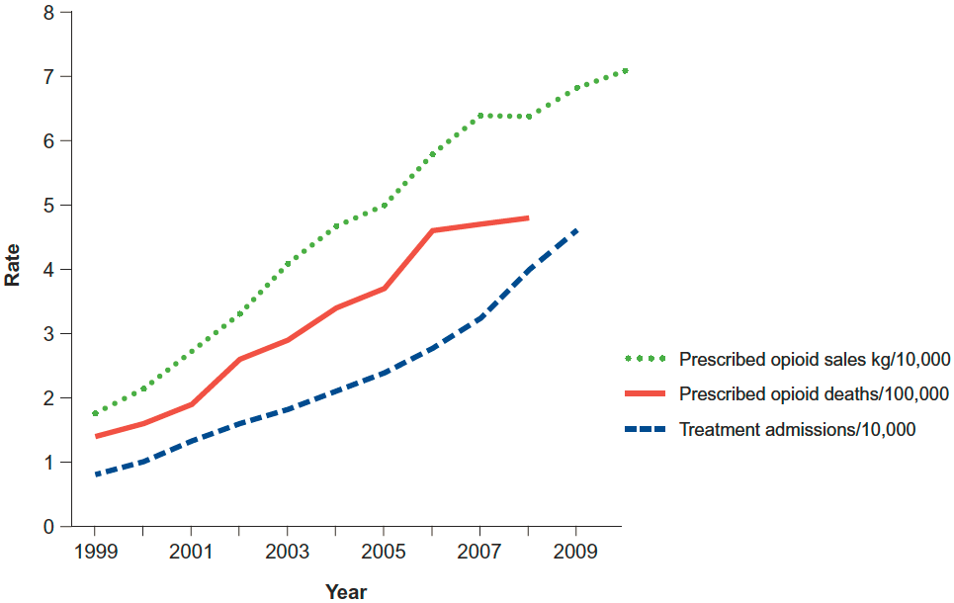
Low back pain: Treatment
108% increase in opiod/narcotics for low back Pain (Deyo)
228% increase in spinal injections (Manchikanti)
220% increase in spinal fusions (US Dept of Health and Human Services,Deyo)
Orthobiologics??

Slide 16
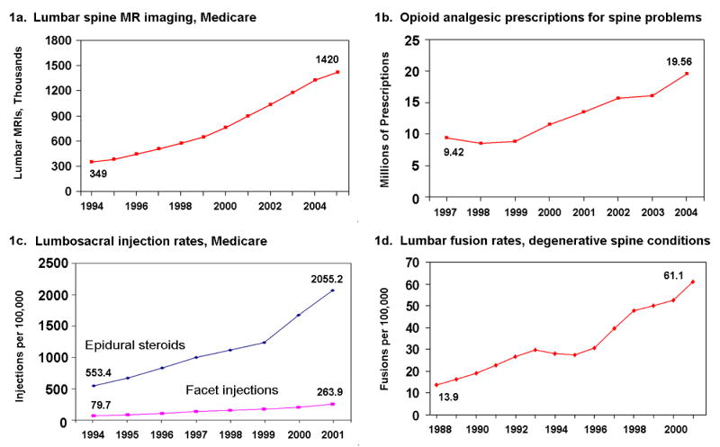
Low Back Pain: Treatment

Slide 17
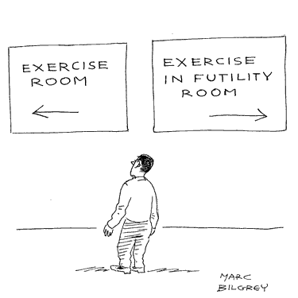
Low Back Pain: Treatment
However…no change in overall incidence of back pain or disability

Slide 18
Low back pain: Treatment
Avoid Bed rest..
Based on study in 1966 showing pressure on spine minimized when laying down (Nachemson)
Early return to usual activity = quicker return to work (Deyo).
Exercises in acute phase not likely helpful, but not harmful (Faas).
Meds: NSAIDS / Acetaminophen – helpful
Opiods/Muscle relaxers not more affective than NSAIDS/Acetaminophen (Cherkin).
Spinal injections used as adjuvant treatment to improve pain to allow people to resume activities/exercise.

Slide 19
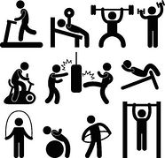
Low back pain: Exercise
Observational Studies:
People who are physically active 3 days a week have lower lifetime risk of back pain (Hareby)
Former athletes had less low back pain (Viderman)
Greater amount of exercise does not increase risk of LBP (Croft)
Higher levels of fitness related to improved back health (Suni)
Decreased trunk strength and flexibility
associated with back pain (Kato)

Slide 20
Low back Pain: Exercise Physical therapy
The Influence of Intense Exercise-based Physical Therapy Program on Back Pain Anticipated Before & Induced By Physical activities (Rainville)

Slide 21
Low back pain: intense Exercise Physical Therapy
Rainville

Slide 22
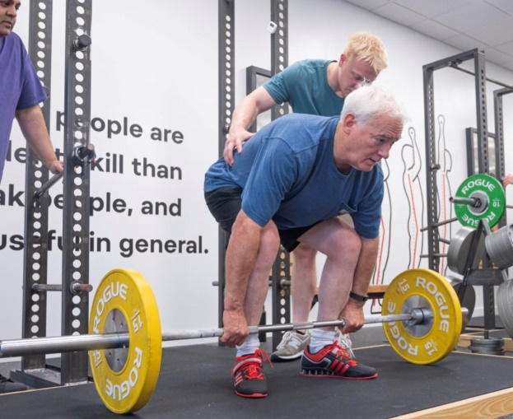
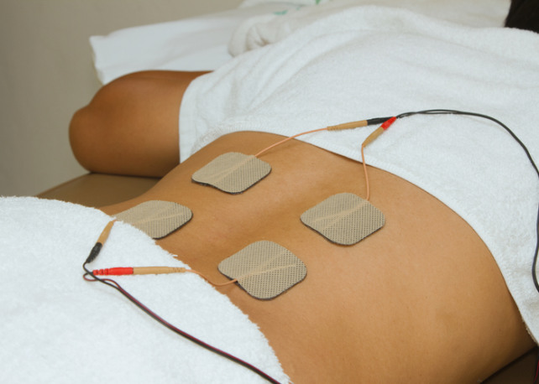
Low back pain: Exercise benefits
ACTIVE VS PASSIVE
Active Exercises more effective than passive therapy (Owen)
Exercising cuts the risk of getting back pain by 50% compared to passive treatments (Stephens)
>

Slide 23
Low back pain: Exercise benefits
IMPROVE MOBILITY
Improve flexibility, strength and endurance activities (Rainville)
DECREASE PAIN
Up to 54% reduction in back pain (Kankaanpaa)
Decrease recurrence of back pain by 40% (Freburger)
Resistance exercises and stabilization exercises reduce low back pain (Peek).
Exercise can reduce pain and improve function (Hayden)
Aerobic training, flexibility and strengthening all important to decrease back pain flairs (Gordon)
DECREASE DISABILITY
Exercise can improve occupational function and reduce
sick leave (Moffett,Lindstrom)
Reduce back pain-related disability (Rainville)
Exercises reduce back pain flairs and disability (Shiri)

Slide 24
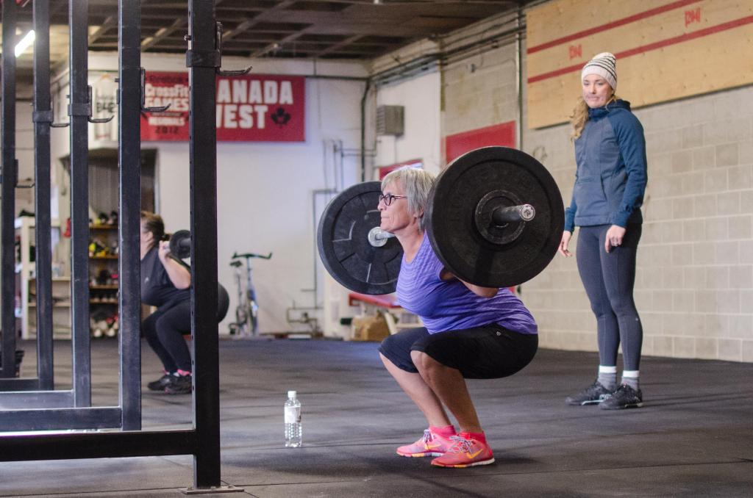
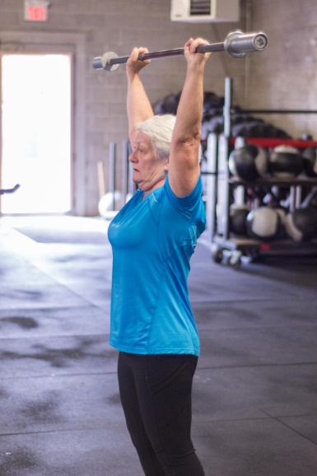
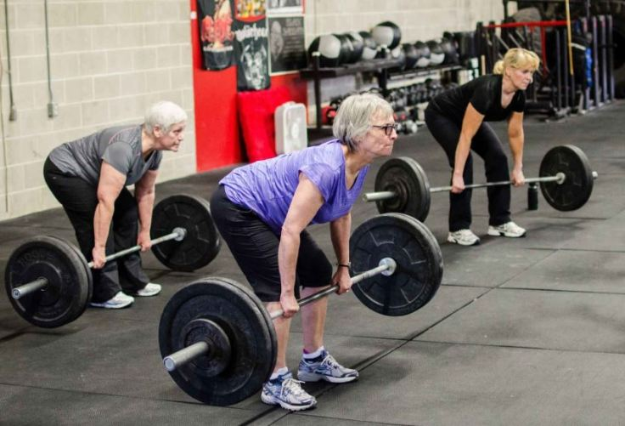
Low back pain: Exercise benefits
STRENGTH TRAINING
Strengthening exercises more effective than other exercises for back pain (Searle, Tian)
Strengthening exercises improves pain and function in the elderly (Zahari)
Posterior chain strengthening exercises greater than general exercise for back pain (Tataryn)
Free weight strengthening improves pain and function (Lee)

Slide 25
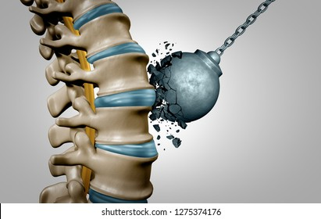
Low back pain: Strength Training
INCREASE PARASPINAL STRENGTH
Combination exercise program of strength training plus walking. (Lee)
10 min dynamic warm up
30 min strength training: Squat, lunge, step-up, plank, back extension, push-ups, bridge
10 min stretching
Significantly improved back muscle strength and pain levels on VAS.
Fat and muscle mass measured before and after 12 weeks of exercise program.
Decrease in fat mass
Increase in muscle mass

Slide 26
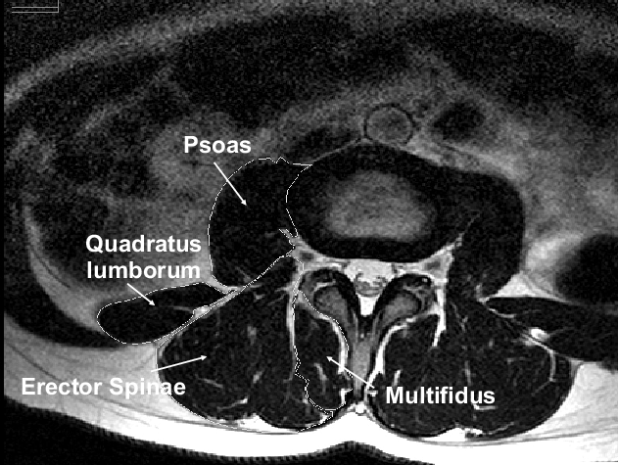
Low back pain: Strength Training
INCREASE PARASPINAL STRENGTH
Free-weight-based resistance training in chronic low back pain patients. (Welch)
Participants completed a Visual Analogue Pain Scale, Oswestry Disability Index and Euro-Qol V2 quality of life measure at baseline and every 4 weeks throughout the study.
Exercises: Glute bridges, overhead squat, deadlift, step ups, lat pull downs, push ups
reductions in pain and disability
(72% and 76% respectively)
significant improvement in strength endurance
reduction in fat infiltration and increased FCSA

Slide 27
Low back pain: Exercise vs Weight Loss
Weight Loss compared to Exercise.
Review of observational studies (Gaesser)
Weight loss associated with a 10-15% reduction in mortality.
Increased exercise activity associated with 15-60% reduction in mortality.
Exercise and Longevity
Middle-aged people who walked atleast 7K steps a day showed 50-70% decrease in mortality from CVD and cancer over the next 10 year period. (Paluch)

Slide 28
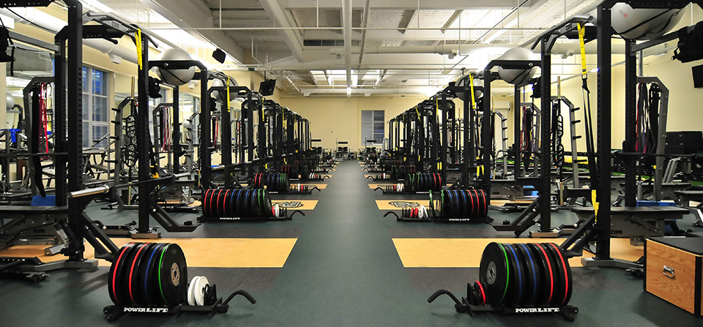
Low back Pain: Exercise Physical therapy
High Intensity, constantly varied, functional movements: Exercise with a Target Heart rate 60-85% intensity using the Karvonen formula.
Non-pain contingent, quota-based physical therapy: Stepwise progressive therapy where the focus is on functional gain instead of pain reduction

Slide 29
Low back Pain: Exercise Physical therapy
Resistance exercise program.
Type of exercise not as important as doing regular resistance strength program (Dettori, Bendix, Bentsen)
High intensity workout more important then frequency (Stagg)
Spinal strengthening (the core) exercises and leg exercises important to include.
Exercising will cause discomfort/pain initially.
Safe to continue through mild/tolerable pain…not harmful pain.

Slide 30
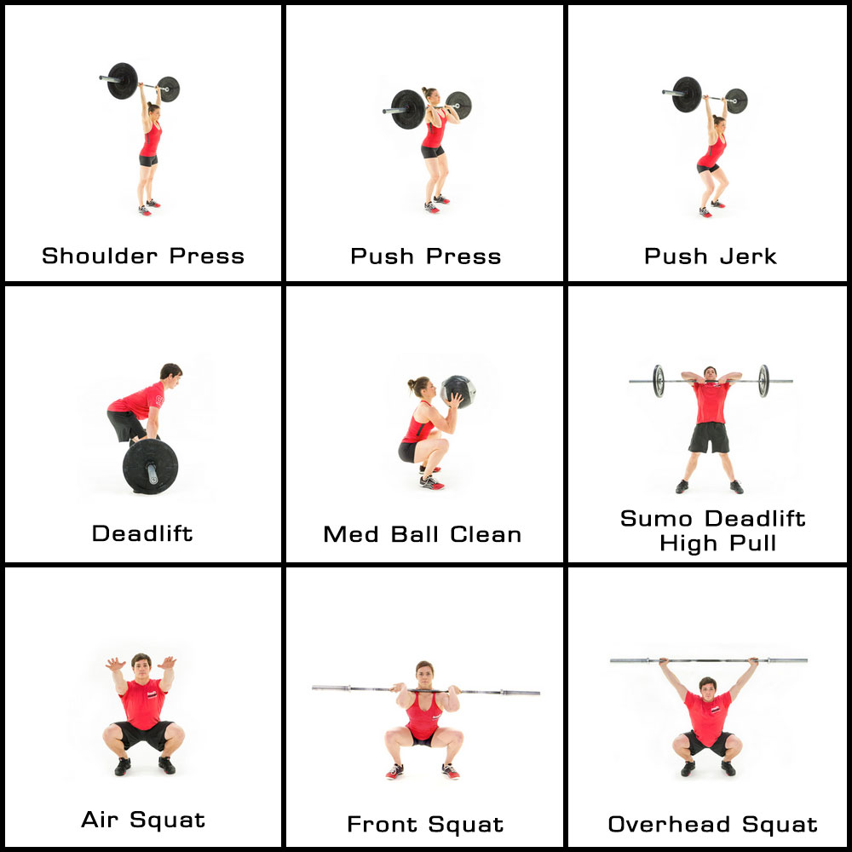
Exercise Training
Educated coaching focusing on movement dysfunction and abnormal muscle strain patterns
Help patients understand how to train
with quality movements to restore
proper function and directly impact
their daily lives.

Slide 31
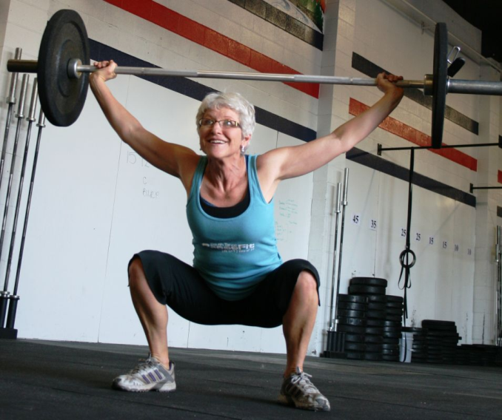
Exercise Training
High Intensity, Constantly-Varied, Functional Movements
2017 study compared 13 studies – same injury rate as other exercise programs (Meyer)
Improves CV endurance (VO2max), stamina, strength, flexibility, power and balance (Gianzina)
Improves lean body mass (Wagener, Shultz)
7% lower body fat, greater isometric strength, peak aerobic capacity compared to recreational exercise (Mangine)
Higher levels of sense of community, satisfaction
and motivation (Claudino)

Slide 32
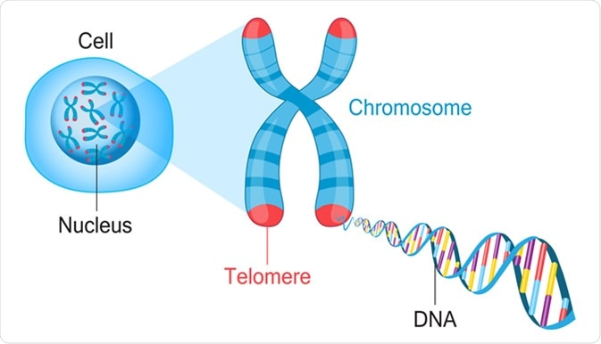
Low back pain: Strength Training
INCREASE LONGEVITY
Telomers: caps at end of chromosomes that shortens with age
Higher levels of activity = longer telomers
Activity >30min 5 days a week had telomers that were 9 years younger than those that were sedentary. (Tucker)
High Intensity Interval Training lengthens telomers (Werner)
Mitochanodrial quality and activity decreases with age leading to age-related diseases
Exercised Muscles have more mitochandria (Haas)

Slide 33
Low back pain: Nutrition
Multiple studies show whole food plant-based diet may alleviate painful symptoms
Reduce inflammation (Fraser, Sutliffe)
Decreased CRP
Decreased IHD and Colon CA
Decreased Erectile Dysfunction
Reduce pain and Improve function in chronic musculoskeletal pain patients (Towery)
Associated with healthier weight (Tonstad)
Lower BMI
Promote healthy gut bacteria (Tomova)
Microbial metabolites can have diverse positive health effects
local anti-inflammatory and immunomodulatory effects
systemic anti-obesogenic and antioxidant effects
Improves SF-36 self-assessed measures of functional status among osteoarthritis patients (Clinton)

Slide 34
Low back pain: Nutrition
Kjeldsen-Kragh J et al:
1-year intervention tested the effects 3.5 months of a gluten-free vegan diet and gradual adoption of a vegetarian diet for the remainder of the study period.
Improved number of tender and swollen joints
Decreased pain score
Decreased morning stiffness
Increased grip strength
Erythrocyte sedimentation rate, C-reactive protein, White blood cell count
Improved health assessment questionnaire score
These improvements were maintained after 1 year

Slide 35
Low back pain: Nutrition
McDougall et al:
4-weeks low-fat vegan diet
Significantly improve joint pain, stiffness, swelling
Improved Function Score

Slide 36
Low back pain: Nutrition
Reduce:
Food made in a factory
Processed foods: soft drinks, candy, chips, foods with added sugar
Simple Carbohydrates: white bread, bagels, pizza
Red Meat
Fried Food
Increase:
Food grown on a farm
Veggies
Fruits
Nuts
Legumes and Beans
Water!

Slide 37
Live a Healthy Lifestyle
People who follow 5 Habits increase life expectancy by up to 10 years (Yanping)
Eat nutritious whole food
Exercise regularly ( 30 min mod to high intensity)
Maintain healthy body weight (BMI<25)
Limit alcohol (1-2 5oz glasses per day)
No smoking

Slide 38
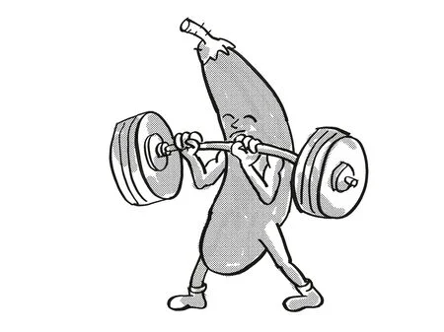

Slide 39
Low back pain
“It’s not a question of whether you will hurt, or of how much you will hurt; it’s a question of what you will do, and how well you will do it, while pain has her wanton way with you.”
Excerpt From Daniel James Brown: The Boys in the Boat.

Slide 40
References
Goubert, L., G. Crombez, and I. De Bourdeaudhuij, Low back pain, disability and back pain myths in a community sample: prevalence and interrelationships. Eur J Pain, 2004. 8(4): p. 385-394.
Butler, D.S. and G.L. Moseley, Explain Pain:(Revised and Updated). 2013: Noigroup Publications.
Lane, N., J. Oehlert, D. Bloch, et al., The relationship of running to osteoarthritis of the knee and hip and bone mineral density of the lumbar spine: a 9 year longitudinal study. The Journal of Rheumatology, 1998. 25(2): p. 334-341
Wai, E., D. Roffey, P. Bishop, et al., Causal assessment of occupational lifting and low back pain: results of a systematic review. Spine J, 2010. 10(6): p. 554-566.y. The Journal of Rheumatology, 1998. 25(2): p. 334-341
Wai, E., D. Roffey, P. Bishop, et al., Causal assessment of occupational bending or twisting and low back pain: results of a systematic review. Spine J, 2010. 10(1): p. 76-88.
Verbeek, J., M.-J. Sengers, L. Riemens, et al., Patient expectations of treatment for back pain: a systematic review of qualitative and quantitative studies. Spine, 2004.29(20): p. 2309-2318.

Slide 41
References
Lawrence RC, Helmick CG, Arnett FC. Estimates of the prevalence of arthritis and selected musculoskeletal disorders in the United States. Arthritis & Rheumatism 1998; 41:778-799
Leigh JP, Markowitz SB, Fahs M et al. Occupational injury and illness in the United States. Estimates of costs, morbidity, and mortality. Arch Inter Med 1997; 157:1557-1568
Deyo RA, Tsui-Wu YJ. Descriptive epidemiology of low back pain and its related medical care in the United States. Spine 1987; 12:264-268
Loney PL, Stratford PW. The prevalence of low back pain in adults. A methodological review of the literature. Physical Therapy 1999; 79:384-396.
Shekelle PG, Markovich M, Louie R. An epidemiologic study of episodes of back pain care. Spine 1995; 20:1668-1673.
Miedema HS, Chorus AMJ, Wevers CWJ et al. Chronicity of back problems during working life. Spine 1998; 23:2021-2029
Martin BI, et al. Trends in health care expenditures, utilization, and health status among Us adults with spine problems, 1997-2006. Spine 2009; 34:2077-84.
Manchikanti L, Falco FJ, Singh V, et al. Utilization of interventional techniques in managing chronic pain in the Medicare population: analysis of growth patterns from 2000 to 2011. Pain Physician. 2012;15(6):e969-e982.
UsDpartment of Health and Human Services: Office of Inspector General. Spinal Devices Supplied by Physician-Owned Distributors: Overview of Prevalence and Use. October 2013.

Slide 42
reference
Martin et al, Expenditures and Health Status Among Adults With Back and Neck Problems. JAMA.. 2008; 299(6): 656-664.
Deyo RA et al. J Am Board Fam Med 2009;22:62
Atlas. J Gen Intern Med. 2001 Feb; 16(2):120-131
Nachemson. The load on lumbar disks in different positions of the body. A Clin Orthop Relat Res. 1966 Mar-Apr; 45():107-22.
Deyo. How many days of bed rest for acute low back pain? A randomized clinical New Engl J Med. 1986 Oct 23; 315(17):1064-70.
Faas. A randomized, placebo-controlled trial of exercise therapy in patients with acute low back pain. Spine (Phila Pa 1976). 1993 Sep 1; 18(11):1388-95.
Cherkin. Medication use for low back pain in primary Spine (Phila Pa 1976). 1998 Mar 1; 23(5):607-14
Koskenniemi. The treatment of acute low back pain--bed rest, exercises, or ordinary activity? N Engl J Med. 1995 Feb 9; 332(6):351-5.
Hoy. The Epidemiology of low back Pain. Best Pract Res Clin Rheumatol. 2010 Dec; 24(6): 769-81
Freburger. The Rising Prevalence of Chronic Low Back Pain. Arch Intern Med. 2009 Feb 9; 169(3): 251-258.

Slide 43
reference
Carey TS, Garrett J, Jackman A, McLaughlin C, Fryer J, Smucker DR. The outcomes and costs of care for acute low back pain among patients seen by primary care practitioners, chiropractors, and orthopedic surgeons. The North Carolina Back Pain Project. N Engl J Med. 1995;333(14):913–917.
Rainville. Exercise as Treatment for chronic low back pain. The Spine Journal. Jan,2004. 4(1) 06-115.
Peek. Br J Sports Med 2015 50(3) p 188.
Christensen. Spinal curves and Health. J Manipulative Physiol Ther. 2008. 31(9) 690-714
Jensen. Magnetic resonance imaging of the lumbar spine in people without back pain. N Engl J Med. 1994. 14;331(2) 69-73.
Boden. Abnormal magnetic resonance scans of the lumbar spine in asymptomatic subjects. J Bone joint surg Am 1990. 72(3) 403-8.
Großschädl F, Freidl W, Rásky É, Burkert N, Muckenhuber J, Stronegger WJ (2014) A 35-Year Trend Analysis for Back Pain in Austria: The Role of Obesity. PLoS ONE 9(9): e107436. doi:10.1371/journal.pone.0107436
Hayden JA, van Tulder MW, Malmivaara A, Koes BW. Exercise therapy for treatment of non-specific low back pain. Cochrane Database Syst Rev 2005;3:CD000335.

Slide 44
Reference
Moffett, Randomized controlled trial of exercise for low back pain. BMJ. 1999 July 31; 319(7205):279-83
Lindstrom. The effect of graded activity on patients with subacute low back pain. Phys Ther. 1992 Apr; 72(4):279-90
Dettori. The effects of spinal flexion and extension exercies. Spine 1995 Nov; 20 (21):2303-12
Bendix. Functional restoration versus outpatient physical training. Spine 2000. Oct; 25(19): 2494-500
Bentsen. The effect of dynamic strength back exercise and or home training program. Spin. 1997 July; 22(13): 1494-500
Rainville. Spine J 2004 Mar-Apr 4 (2): 176-83
Chatzitheodorou D Kabitsis C Malliou P Mougios V, Phys Ther (2007 Mar) 87(3):304-12
Stagg NJ. Anesthesiology (2011 Apr) 114(4):940-8
O’sullivan. The Body Matters. British Journal of Sports Medicine. Apr 2015.
Loprinzi. Healthy Lifestyle Characteristics… Mayo Clinic Proceedings. April 2016 91(4):432-442.

Slide 45
References
Fraser GE. Associations between diet and cancer, ischemic heart disease, and all-cause mortality in non-hispanic white california seventh-day adventists. Am J Clin Nutr. 70 (1999) (Suppl. 3):532S−8. doi: 10.1093/ajcn/70.3.532s
Appleby PN, Thorogood M, Mann JI, Key TJ. The oxford vegetarian study: an overview. Am J Clin Nutr. (1999) 70(Suppl. 3):525S−31. doi: 10.1093/ajcn/70.3.525s
Tonstad S, Butler T, Yan R, Fraser GE. Type of vegetarian diet, body weight, and prevalence of type 2 diabetes. Diabetes Care. (2009) 32:791–6. doi: 10.2337/dc08-1886
Sutliffe JT, Wilson LD, de Heer HD, Foster RL, Carnot MJ. C-reactive protein response to a vegan lifestyle intervention. Complement Ther Med. (2015) 23:32–7. doi: 10.1016/j.ctim.2014.11.001
Towery. Chronic musculoskeletal pain and function improve with a plant-based diet. Complement Ther Med. 2018 Oct;40:64-69.
Tomova, Front. Nutr., 17 April 2019 | https://doi.org/10.3389/fnut.2019.00047
Kjeldsen-Kragh J, Haugen M, Borchgrevink CF, Laerum E, Eek M, Mowinkel P, et al. Controlled trial of fasting and one-year vegetarian diet in rheumatoid arthritis. Lancet. (1991) 338:899–902. doi: 10.1016/0140-6736(91)91770-U
McDougall J, Bruce B, Spiller G, Westerdahl J, McDougall M. Effects of a very low-fat, vegan diet in subjects with rheumatoid arthritis. J Alternat Complement Med. (2002) 8:71–5. doi: 10.1089/107555302753507195
Tonstad S, Nathan E, Oda K, Fraser G. Vegan diets and hypothyroidism. Nutrients. (2013) 5:4642–52. doi: 10.3390/nu5114642
Abbasi, J. AMA. 2019;321(22):2149-2151. doi:10.1001/jama.2019.3910
Yanping “The Impact of Healthy Lifestyle Factors on Life Expectancies in the US Population,” Yanping Li, An Pan, Dong D. Wang, Xiaoran Liu, Klodian Dhana, Oscar H. Franco, Stephen Kaptoge, Emanuele Di Angelantonio, Meir Stampfer, Walter C. Willett, Frank B. Hu, Circulation, April 30, 2018, doi: 10.1161/CIRCULATIONAHA.117.032047
Clinton, Whole-Foods, Plant-Based Diet Alleviates the Symptoms of Osteoarthritis. Arthritis. 2015; 2015: 708152.

Slide 46
References
Gordon, Bloxham. A Systemic Review of the Effects of Exercise and Physical Activity on Non-Specific Low Back Pain. Healthcare. 2016 Jun:4(2):22.
Owen. Which specific Modes of Exercise Training are most effective for treating low back pain.BJSM Volume 54, Issue 21
Zahari. Effectiveness of strengthening exercises for the elderly with low back pain.. Scientifica. Vol2016, May 2016.
Tataryn. Posterior chain resistance training compared to general exerciseand walking programmes for treatment of chronic low back pain. Sports Med. March 2021. Article number 17.
Searle. Exercise interventions for the treatment of chronic low back pain. Clinical Rehab. 2015. Vol 29(120. 1155-1167.
Tian. Comparative effectiveness of exercise interventions for low back pain. The Lancet. 2018, 392(21)
Shiri. Exercises for the prevention of low back pain. Am. Jour of Epi. Vol 187. Issue 5, May 2018.
Stephens. Prevention of low back Pain. JAMA. 2016; 176(2)
Welch. The effects of free-weight-training-based resistance training intervention on pain. BMJ. Vol1 (1)
Kato. Association of low back pain with muscle weakness... PLOS. 2022

Slide 47
References
Tucker. Preventive Medicine. Vol 100, July 2017.
Werner. Differential efects of endurance, interval and resistance training on telomerase activity. European Heart Journal. Vol 40, Issue 1, 2019.
Haas. Mitochondrial Dysfunction… Biology. 2019. 8(2): 48.
Paluch. Steps per Day and All Cause Mortality… JAMA 2021; 4 (9).
Gaesser. Obesity treatment. iScience. Vol 24 (10). 2021.
Lee. J Exerc Rehabil. 2016;12(5):463–470. Published 2016 Oct 31. doi:10.12965/jer.1632650.325

